Slide 1
Tutorial-10
Implement SR flip-flop using NAND gates.
(using both schematic and VHDL ((i)using structural and (ii) using any model)

Slide 2
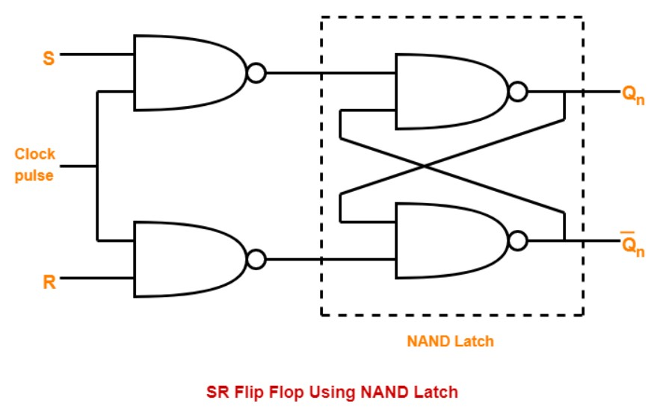
Schematic

Slide 3
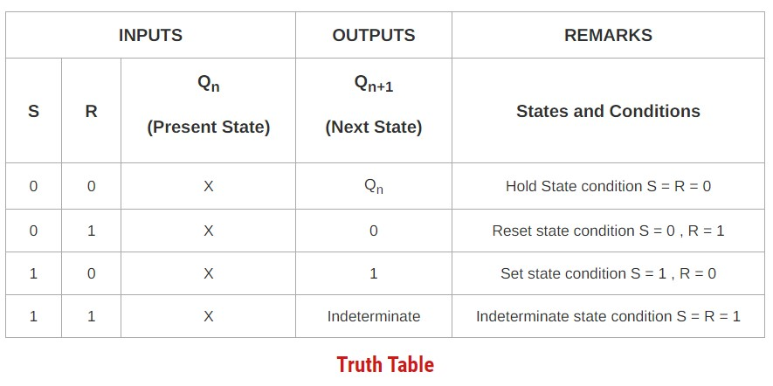

Slide 4
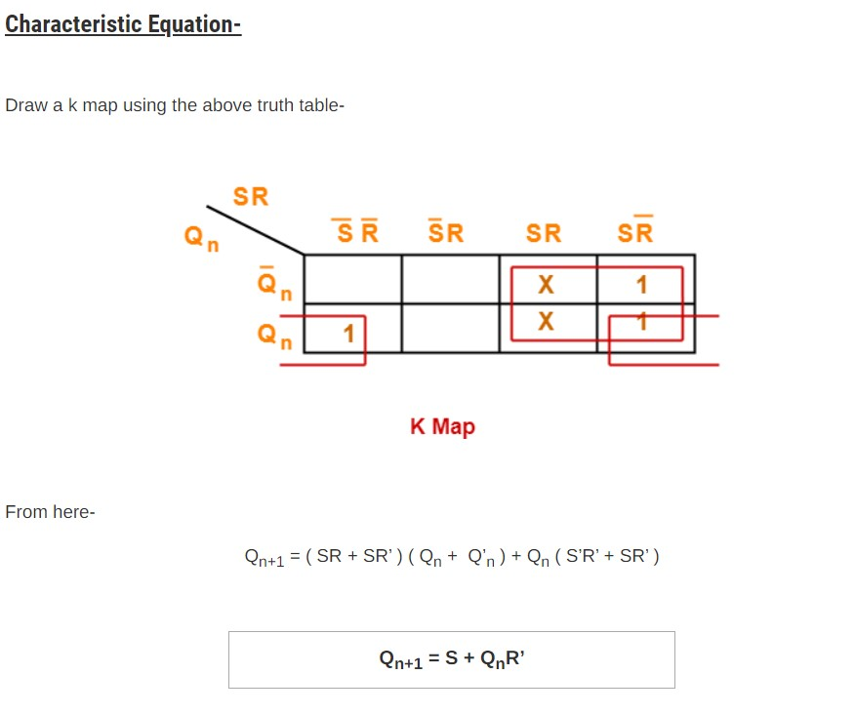

Slide 5
library IEEE;
use IEEE.STD_LOGIC_1164.ALL;
use IEEE.STD_LOGIC_ARITH.ALL;
use IEEE.STD_LOGIC_UNSIGNED.ALL;
entity srffst is
Port ( s,r,clk : in STD_LOGIC;
q,qb : inout STD_LOGIC);
end srffst;
architecture srffstar of srffst is
component nand21
port(a,b: in STD_LOGIC;
y:out STD_LOGIC);
end component;
signal s1,r1:STD_LOGIC;
begin
n1: nand21 port map(s,clk,s1);
n2: nand21 port map(r,clk,r1);
n3: nand21 port map(s1,qb,q);
n4: nand21 port map(r1,q,qb);
end srffstar;
library IEEE;
use IEEE.STD_LOGIC_1164.ALL;
use IEEE.STD_LOGIC_ARITH.ALL;
use IEEE.STD_LOGIC_UNSIGNED.ALL;
entity nand21 is
Port ( a,b : in STD_LOGIC;
y : out STD_LOGIC);
end nand21;
architecture DFM of nand21 is
begin
y <= a nand b;
end DFM;

Slide 6
library ieee;
use ieee. std_logic_1164.all;
use ieee. std_logic_arith.all;
use ieee. std_logic_unsigned.all;
entity RS_FF is
PORT( S,R,CLOCK: in std_logic;
Q, QBAR: out std_logic);
end RS_FF;
Architecture behavioral of RS_FF is
begin
PROCESS(CLOCK)
variable tmp: std_logic;
begin
if(CLOCK='1' and CLOCK'EVENT) then
if(S='0' and R='0')then
tmp:=tmp;
elsif(S='1' and R='1')then
tmp:='Z';
elsif(S='0' and R='1')then
tmp:='0';
else
tmp:='1';
end if;
end if;
Q <= tmp;
QBAR <= not tmp;
end PROCESS;
end behavioral;

